Slide 1
How to write paper?
---Thesis

Slide 2
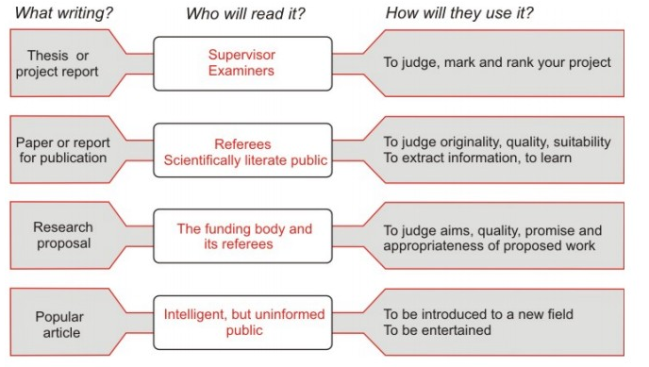

Your idea, your work, experimental results and conclusions, future research direction

Slide 3
Paper is the article of Computer Science
New problem + Traditional Methods
Old problem + New Methods
New problem + New Methods
Old problem+ Traditional Methods + New results

Slide 4
The structure of short paper
Title& Signature
Abstract
Introduction
Preliminary
Your work
  New concepts
  Methods
  results
  Case study
Conclusion & future work
Acknowledge
Reference

Slide 5
Introduction
Which fields can be applied of your topics
What are the difficulties in these fields?/what is the problem? Why does it make sense?
Related research results/What has been done before? Your idea
Notes:
Introduction：
1）问题是什么？为什么它有意义？
2）对这个问题有主要贡献的研究者有哪些？
3）之前做过哪些工作？存在哪些问题？
4）你的新方法是什么？

Slide 6
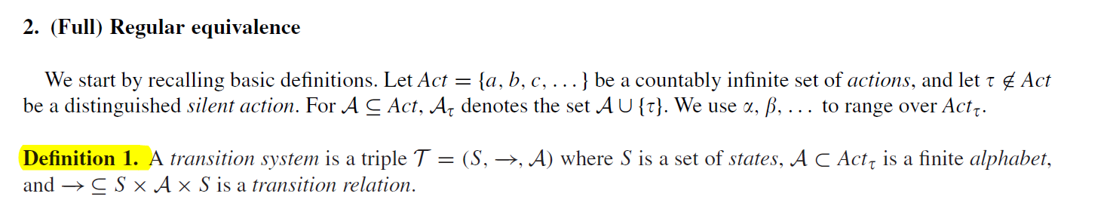
Preliminary
The concepts you will use
The properties you will use
The technology you will use
The results you will use

Slide 7
Main parts
Your new concepts
Your new methods
Your results
Comparison with other results (related work)

Slide 8
Discussion
Extract the main ideas, the relationship between experimental results, and general rules
A discussion can begin by rethinking the research questions and assumptions presented in the "Introduction", and then summarizing your main viewpoints or findings.
Do not use the "big and empty" language and do not exaggerate the importance of the results.

Slide 9
Conclusion
Summed up the most important experimental results and contributions
pointed out the lack of methods and future work direction
Never repeat Abstract

Slide 10
Thesis?
A paper that reports scientific or academic research and is usually subjected to peer review before publication in a scientific journal or in the proceedings of a scientific or academic meeting (such as a conference, a workshop or a symposium).
A written essay, especially one submitted for a university degree.
Dissertation

Slide 11
Thesis is the summary of your research of three/four years
A series of topics in one field
A series of application of one technology
A framework of new topic
Compare to the short paper

Slide 12
The structure of Thesis
Abstract
Introduction (chapter 1)
Preliminary(chapter 2)
Chapter 3 (Theoretical part)
Chapter 4 (Implementation part)
Chapter 5(Some applications)
Conclusion & future work(chapter 6)
Reference

Slide 13
Abstract
To show the importance of topics
The problem you solve
The technology you use
The results you get
Words!

Slide 14
Introduction
Which fields can be applied of your topics
What are the difficulties in these fields?
Related research results
Your idea
Your structure of thesis

Slide 15
Preliminary
Short introduction of this field
The concepts you will use
The properties you will use
The technology you will use
The results you will use

Slide 16
Main Parts(1)
Chapter 3 –Theoretical Part
  New concepts
  New Models
  New Algorithm
  New … can be described formally

Slide 17
Main parts (2)
Chapter 4- Implementation Part
  The toy cases and properties of Models
  The implementation and analysis of your algorithm
  New technology

Slide 18
Main parts (3)
Chapter 5- Application part
  Procedure of the application
  Bigger case study (one or two)

Slide 19
Conclusion
Your contribution
  New topics?
  New technology?
  New results?
Future work is also important

Slide 20
Acknowledgements
Thanks to those who give ideas, technical support, and economic support, including other institutions, classmates, colleagues, family……

Slide 21
Other Comments
  write short paper first!

Slide 22
Team Show

Slide 23
Read Paper
Team
1~2人 10页
2~3人 10~15页
3~4人 >15页

Slide 24
Rice University
Thesis guideline
Notes:
莱斯大学 https://graduate.rice.edu/thesisformat

Slide 26
Paper- Verifying BPEL-like Programs with Hoare Logic
What is BPEL?
BPEL is a formal specification language for automated business processes.
The process of the BPEL with an XML document can be carefully organized between the Web services in a standardized, interactive way
Notes:
BPEL是一门用于自动化业务流程的形式规约语言。 用XML文档写入BPEL中的流程能在Web 服务之间以标准化的交互方式得到精心组织

Slide 27
Key words
compensation
orthogonal
axiomatic system
cater for
syntax
semantic
restriction
snapshot
propagate
scenario
verification
soundness
synchronous communication
补偿
正交
公理系统
迎合
语法
语义
约束
快照
传播
场景
验证
完备性
同步通信
asynchronous

Slide 28
The WS-BPEL language has recently become a de facto standard for modeling Web-based business processes.
One of its essential features is the fully programmable compensation mechanism. To understand it better, many recent works have mainly focused on formal semantic models for WS-BPEL.

Slide 29
In this paper, we make one step forward by investigating the verification problem for business processes written in BPEL-like languages. We propose a set of proof rules in Hoare-logic style as an axiomatic verification system for a BPEL-like core language containing key features such as data states, fault and compensation handling. We also propose a big-step operational semantics which incorporates all these key features. Our verification rules are proven sound with respect to this underlying semantics. The application of the verification rules is illustrated via the proof search process for a nontrivial example.

